Slide 1

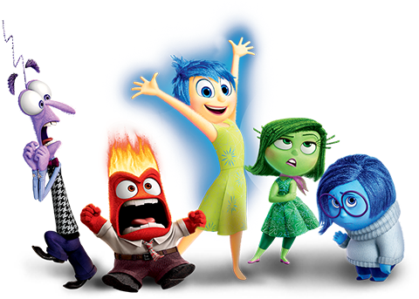
Emotions
CUDAP SIGN CHOIR
cudap@cornell.edu

Slide 2

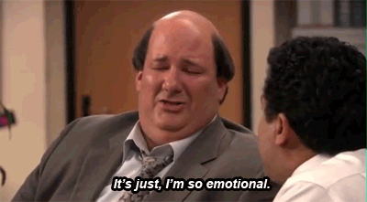
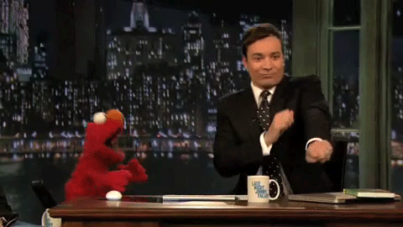
Vocab List
Happy
Sad
Tired
Angry
Afraid
Excited
Bored
Jealous
Hungry
Thirsty
Love
Confused
Proud
Surprised
Disgusted
Annoyed
Embarrassed
Lazy

Slide 3
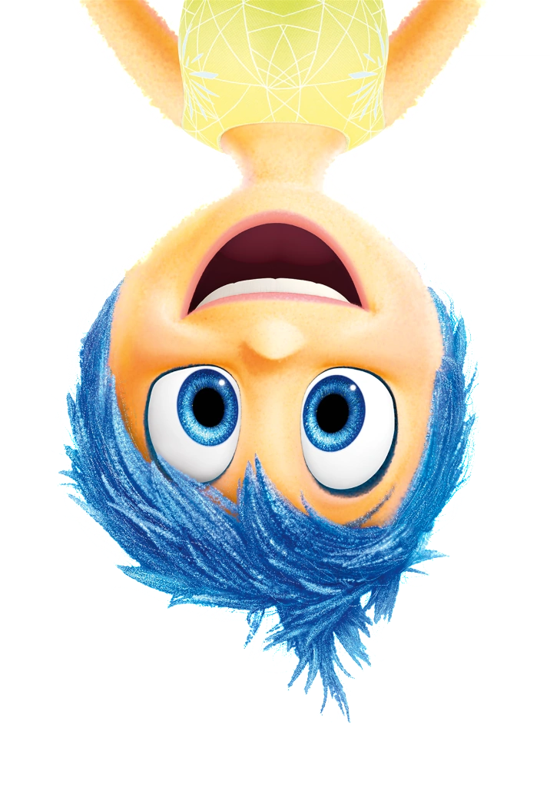
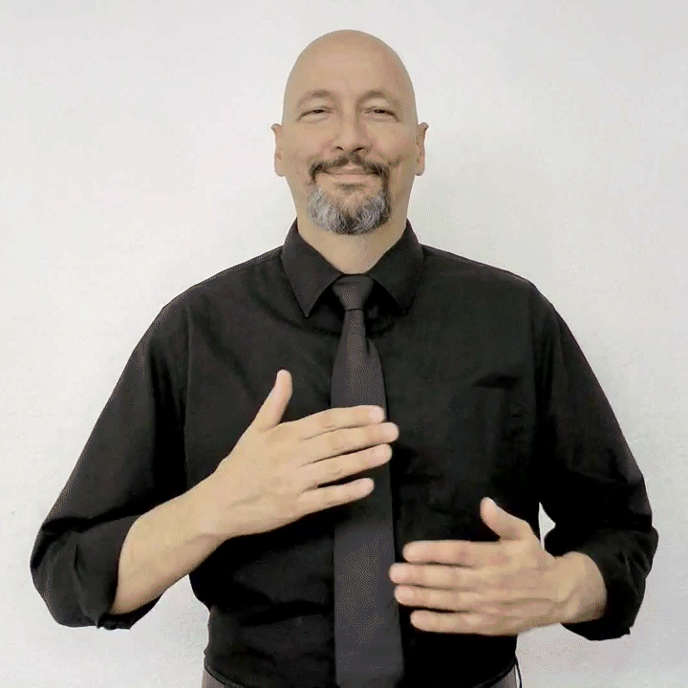
Happy
Description: Circle your hands twice and smile!

Slide 4
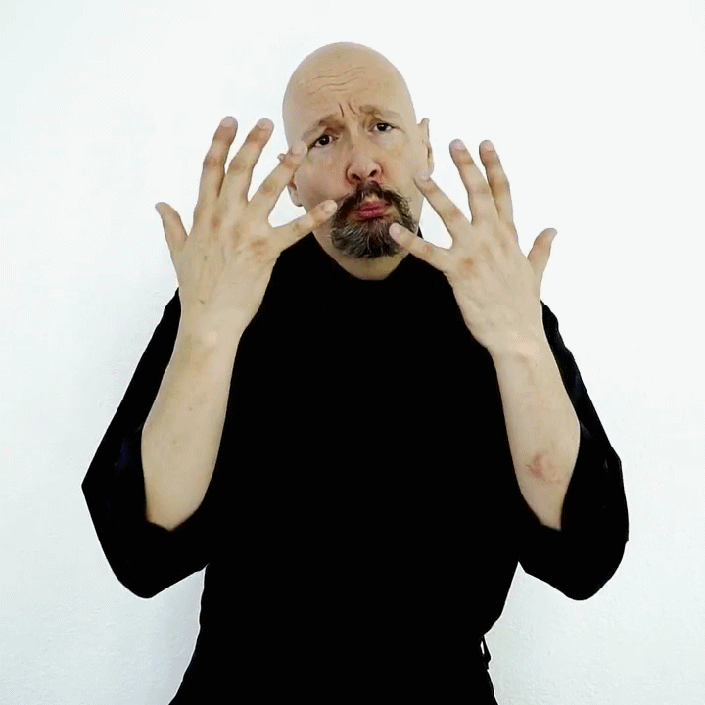
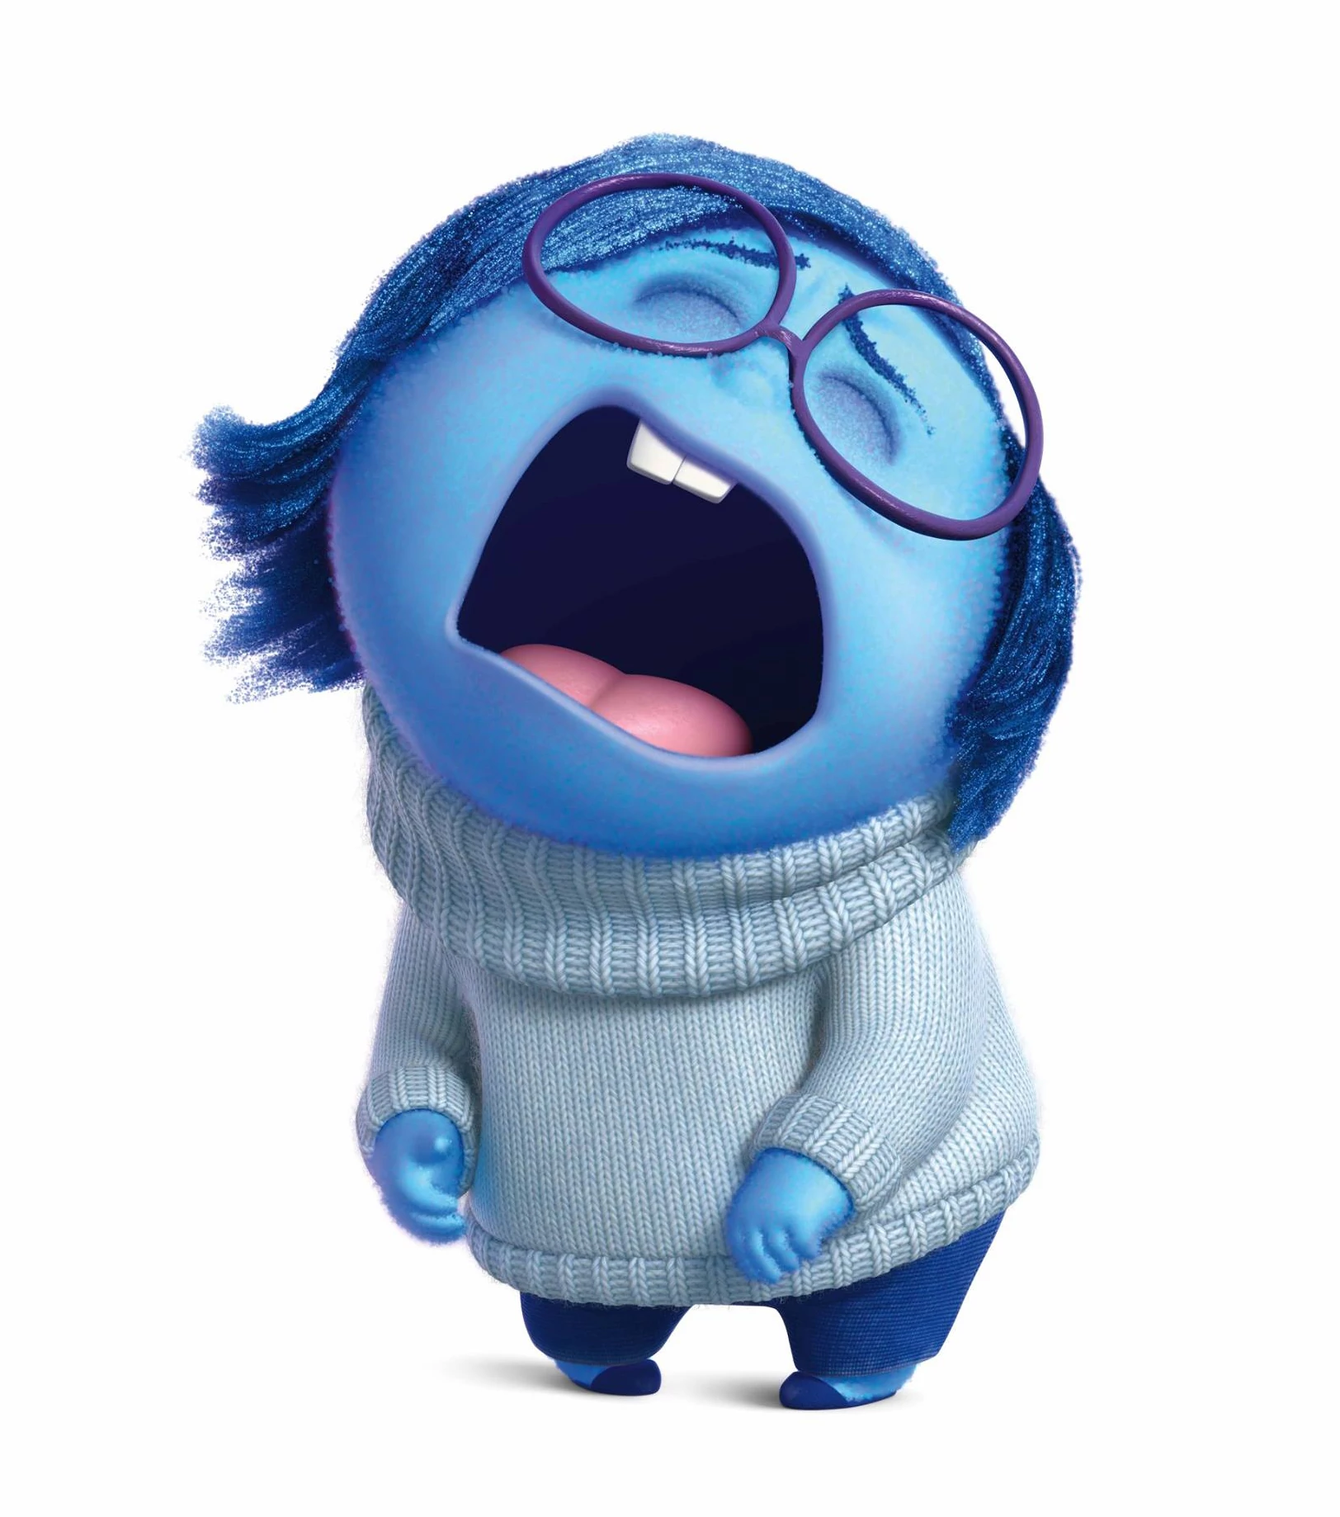
Sad
Description: bring both hands down your face, look sad :(

Slide 5


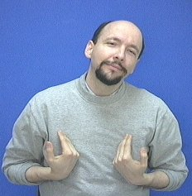
Tired

Slide 6
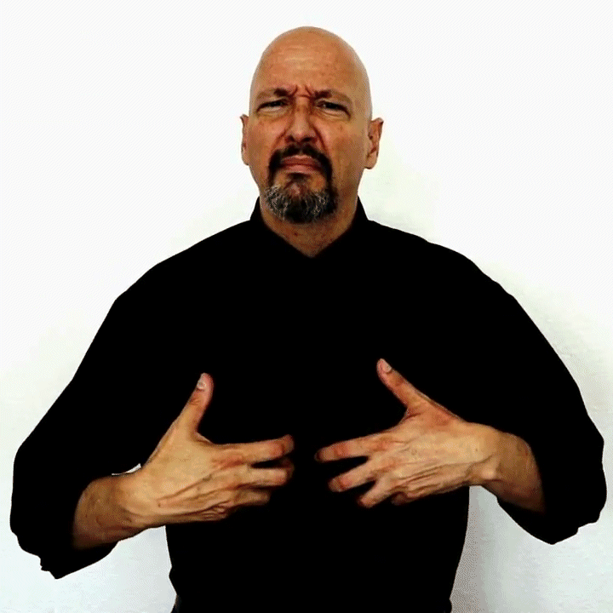
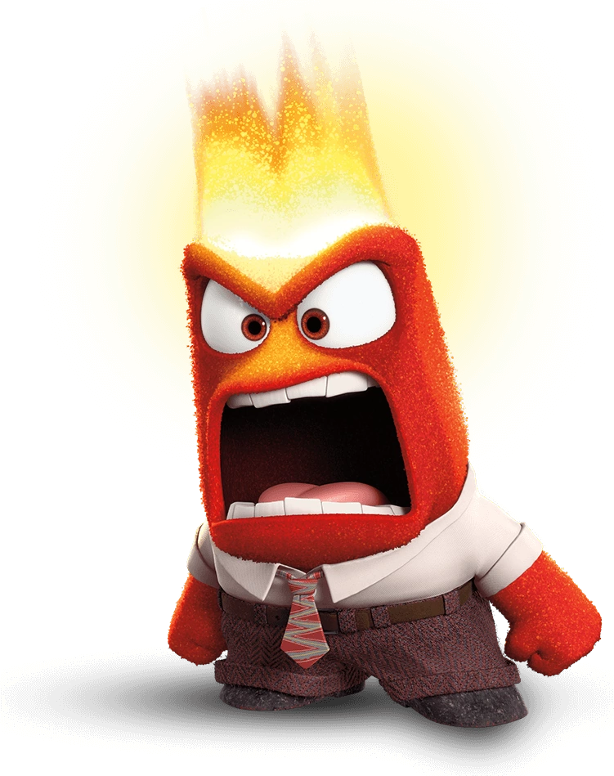
Angry
Description: make 2 “claw” hands and pull them up and out

Slide 7
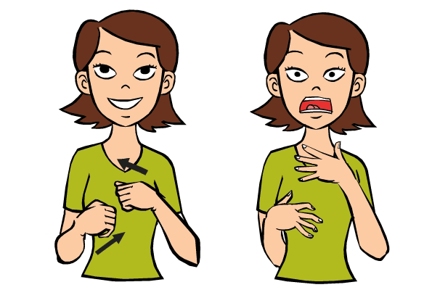
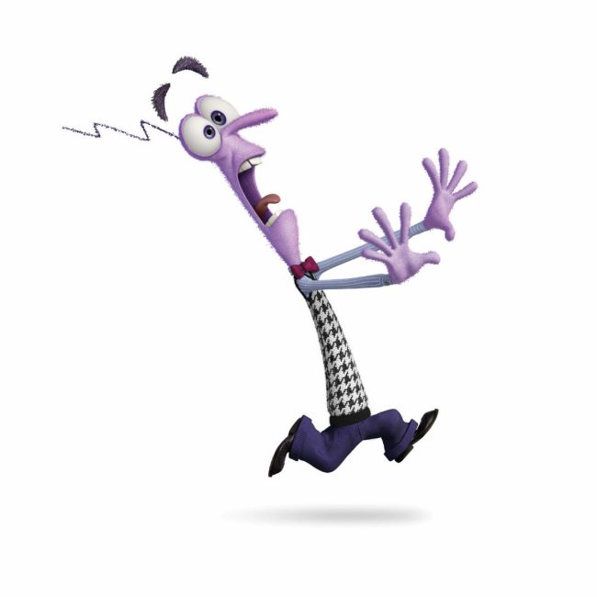
Afraid
Description: bring two closed hands towards your chest, then open them

Slide 8
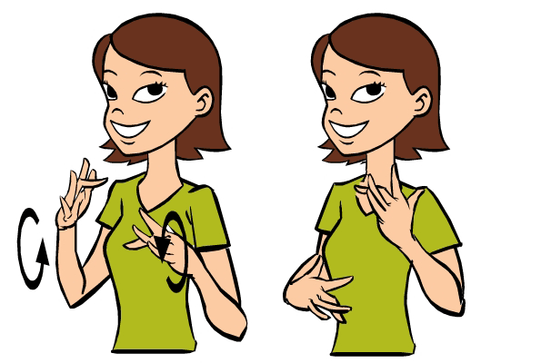
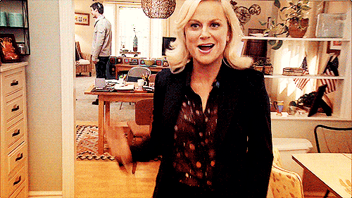
Excited
Description: bend your middle fingers slightly forward, make circles away from your body
Alternative:

Slide 9
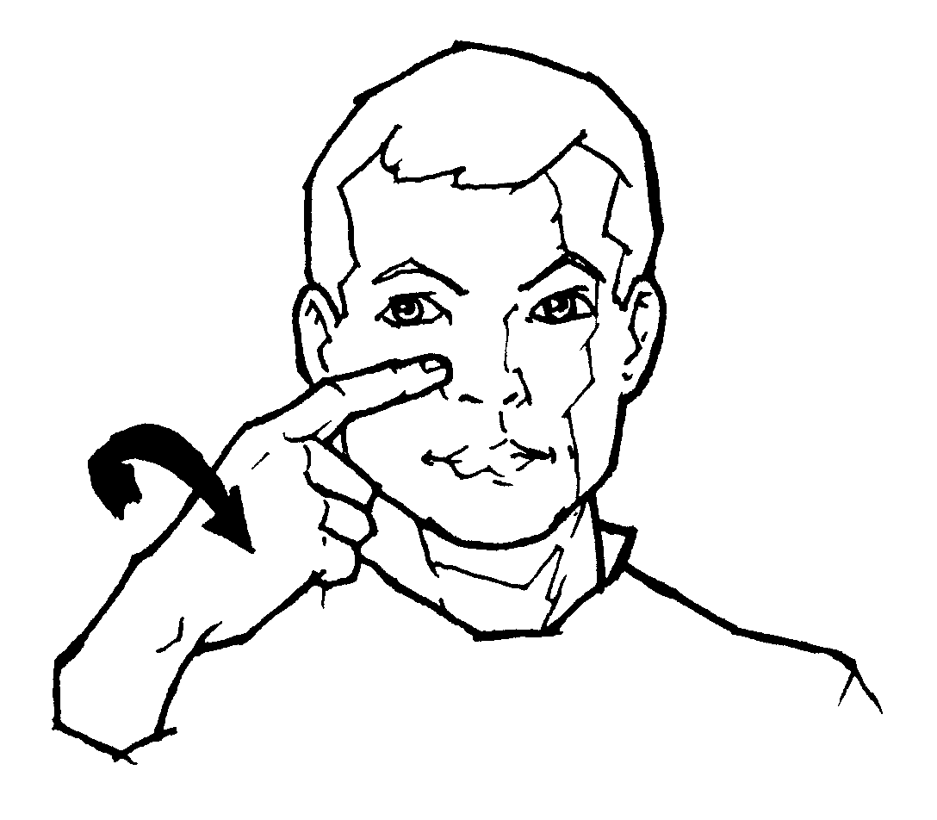
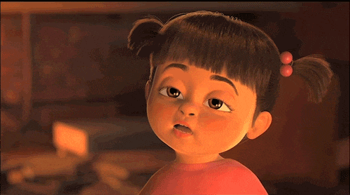
Bored
Description: finger on the right of your nose, twist your wrist inwards

Slide 10
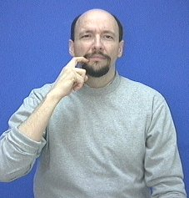
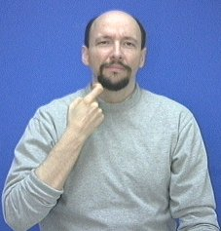
Jealous
Description: make a hook with your index finger, pull it down from your lip

Slide 11
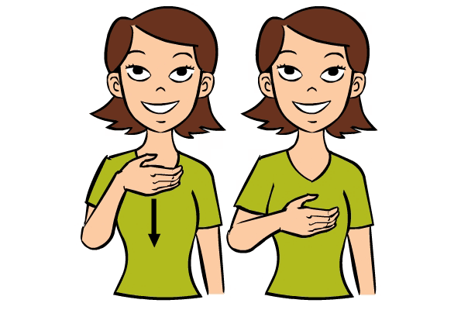
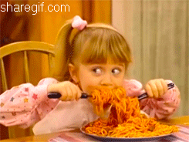
Hungry
Description: make a “C” hand, slide it down your chest (like swallowing food)

Slide 12
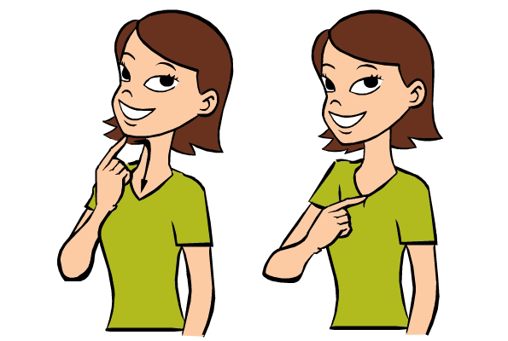
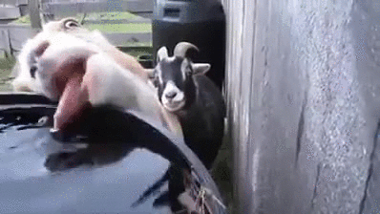
Thirsty
Description: move your index finger down your throat

Slide 13
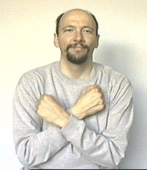
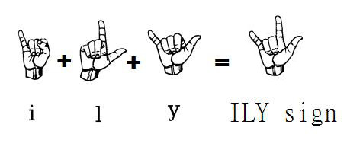
Love
Description: cross your arms over your chest, left over right

Slide 14
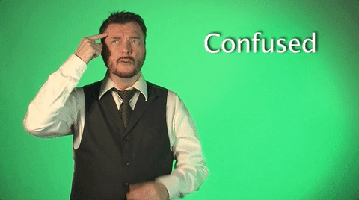
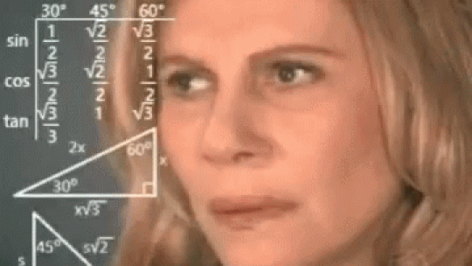
Confused
Description: point to your head, then make circles with 2 “claw” hands

Slide 15
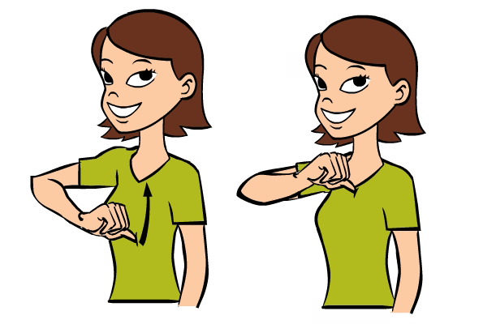
Proud
Description: point your thumb at your stomach, then move it up to your chest

Slide 16
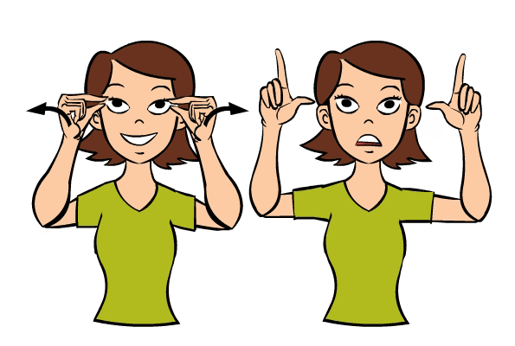
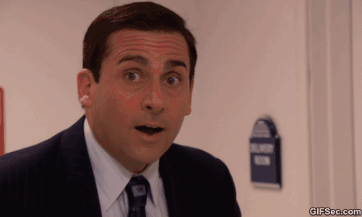
Surprised
Description: touch your index finger and thumb together by your eyes, then open them and look surprised!

Slide 17
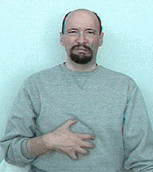
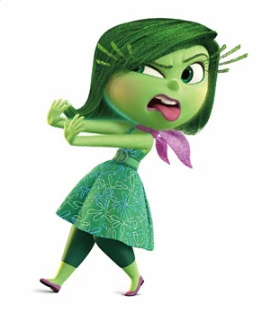
Disgusted
Description: make a “claw” hand and circle it around your stomach

Slide 18
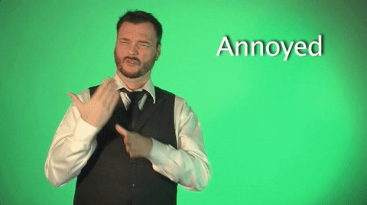
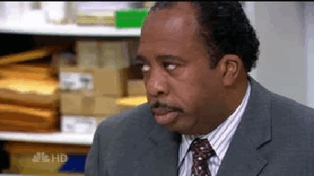
Annoyed
Description: tap the side of your right hand between the thumb/index finger of your left hand

Slide 19
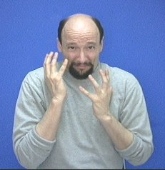
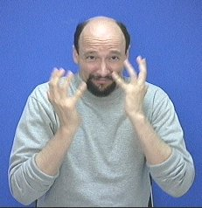
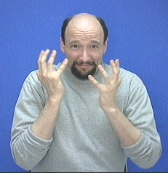
Embarrassed

Slide 20
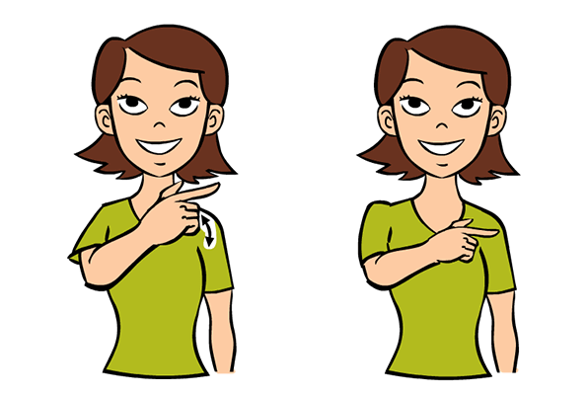
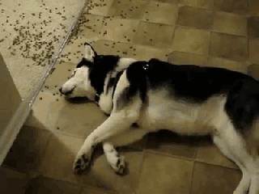
Lazy
Description: make an “L” hand, brush it against the left side of your chest

Slide 21
Questions?

